Slide 1
M.C.T.V
Software Applications Group presentation.
Alex Plunkett: 17331006
Nathan Hodgkiss: 17381176
Dylan Murphy: 17506166
Piyush Sharma: 17342356

Slide 2
The Company.
MCTV Limited is a small family-run retail company based in Limerick.
Owned by Michael and Doreen Cooney.
The company sells televisions/hardware and has been in business for 20 years.
Employs 5 staff members.

Slide 3
The Staff.
Derek (Alex) – Sales & Marketing Manager
Wants to introduce a CRM system to improve customer relations.
Wants to use Microsoft Dynamics for this purpose.
Mark (Dylan) – IT Manager
Wants to improve the website from a basic WordPress site.
Major improvement to the sites online presence.
Roberta (Nathan) – Financial Controller
Wants to invest in an integrated accounts package suggested Sage line 50.
Liam (Piyush) – Social Media Manager
Suggests investment in collaborative software.

Slide 4

Database
Our database has five tables: Customers, Data, Employees, Inventory & Suppliers.
For added functionality, our database includes five forms: Customers, Employees, Inventory, Suggestions & Suppliers.
We have four reports: Customer, Employees, Inventory & Suppliers.
Our database allows for queries: EG – Searching for retail price, Stock value or Suppliers Information.

Slide 5

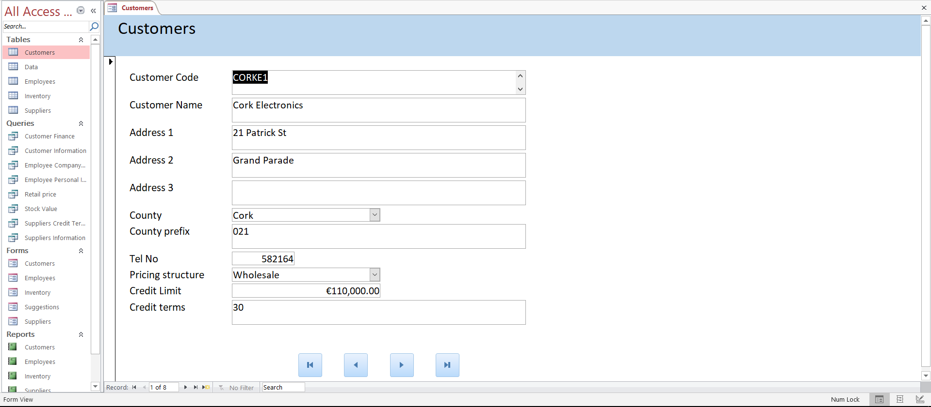
Database

Slide 6
UML Chart
Our UML chart was worked around our four core tables from our database: Customers, Employees, Inventory & Suppliers.
From each table, we extended it to its correlating report, form & queries.
EG: Customer Table extended to – Customer Form, Customer Report & Any queries related to the customer table.

Slide 7

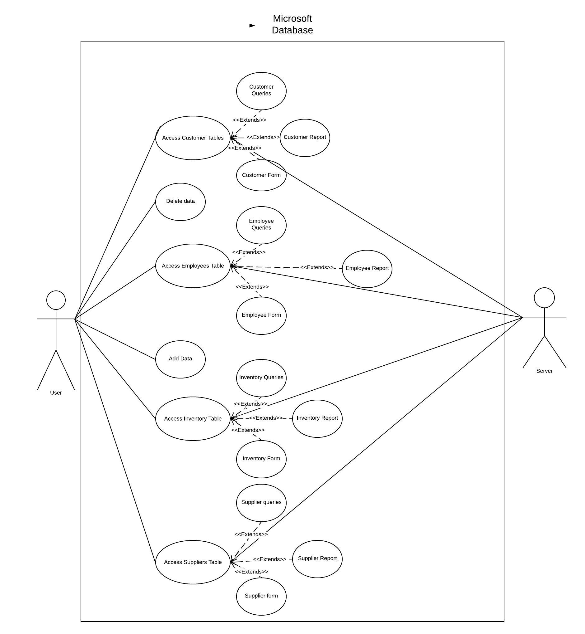

UML Chart
z
z

Slide 8
WordPress
Our website is an integral part of our company, it is the main advertisement for the company.
We are discussing plans to allow online purchases through our website.
Our website was created from a basic version of WordPress
We went for a simple design, as we are a start up company
Our pages include: Home, About Us & Product

Slide 9
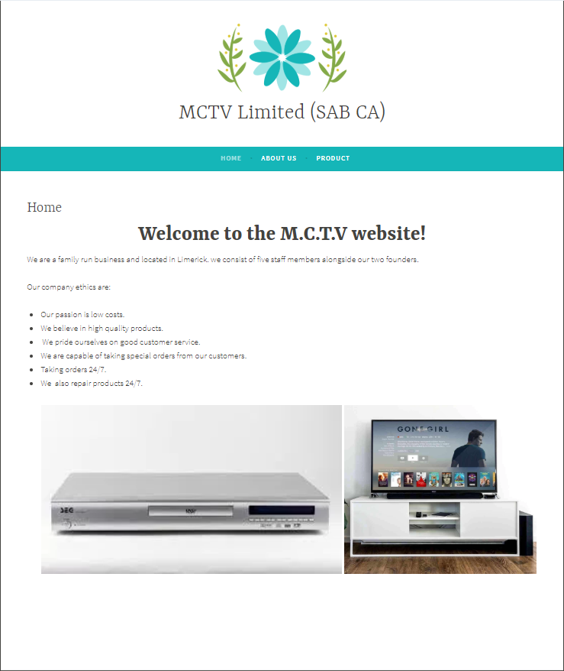
WordPress
z
z

Slide 10
Gantt Chart

Slide 11
Individual Report – Microsoft Dynamics (Derek)
Microsoft Dynamics – Combination of Customer Relation Management Software & Enterprise Resource Planning Software.
Advantages: Cheaper, Well Rounded, Efficient & has excellent security features + support staff.
Competitors:
Salesforce – Accessible + Efficient
Zoho – Cheap + Visually Appealing
Prosper Works – Easy to use + Integration with Google.

Slide 12
Individual Report – Sage Cloud (Roberta)
Sage Cloud – An accounting software for business’.
Sage is far better than Excel, as Excel has many disadvantages.
Instant access from anywhere
Integrates with Microsoft Outlook (customer details etc)
Automatically applies best accounting practices.
Competitors to Sage:
Wave – Free + Lacks features.
QuickBooks Online – Massive app integration + Access anywhere.
Zoho Books: All in one package but lacks support features.

Slide 13
Individual Report – Enhancing the Website (Mark)
WordPress – A website building tool
Propose integrating an online store to the website to increase sales.
Advantages:
Increased Market exposure
More professional visually.
Competitors:
Wix – Drag & Drop Feature.
Weebly – Has its own online store.
SquareSpace - Good security features.

Slide 14
Individual Report – Collaborative Software (Liam)
Slack – Slack is a collaborative software
Slack allows the following functionalities:
Group Calls/Messages
Saves all files to the cloud /Share Files
Easier to use & boasts high reliability (99.99% response rate).
Competitors:
Cureo – No group calls & doesn’t save past data
Samepage – No group calls & not aimed at business’.
WorkFront – Not reliable & poor support

Slide 15
Thank You!

